Slide 1
Lecture-6
Chapter-4
Computer Architecture and Organization- Jhon P. Hayes
Datapath Design

Slide 2
Datapath Design
This lecture will addresses the register-level design of the Datapath (data processing unit).
Fixed-Point Arithmetic:
Fixed-point arithmetic is a numerical computation technique that represents and processes numbers with a fixed number of digits or bits for the integer and fractional parts.
In fixed-point arithmetic, numbers are typically represented in binary form and are stored in fixed-size registers or memory locations.
The design of circuits to implement the four basic arithmetic instructions for fixed-point numbers- addition, subtraction, multiplication and division.

Slide 3
Multiplication
Fixed point multiplication requires substantially more hardware than fixed point addition, and, as a result, it is not included in the instruction set of some is smaller processor.
Multiplication is usually implemented by some form of repeated addition.
A simple but slow method to compute X * Y is to add the multiplicand to Y to itself X times, where X is the multiplier.

Slide 4
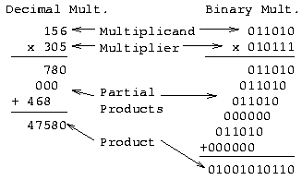
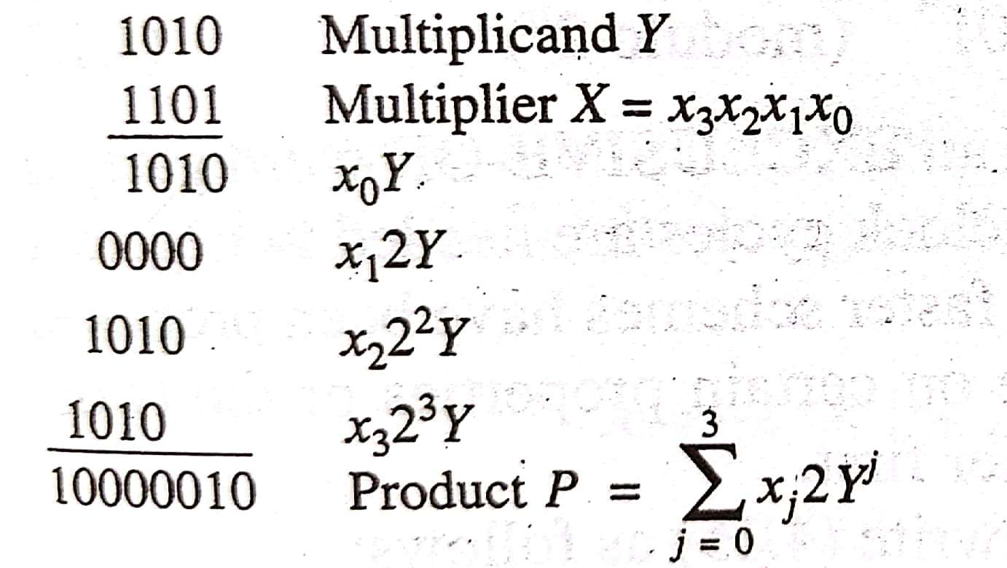
Multiplication H/W
Based on paper-and-pencil method of repeated shift-and-add operations

Slide 5
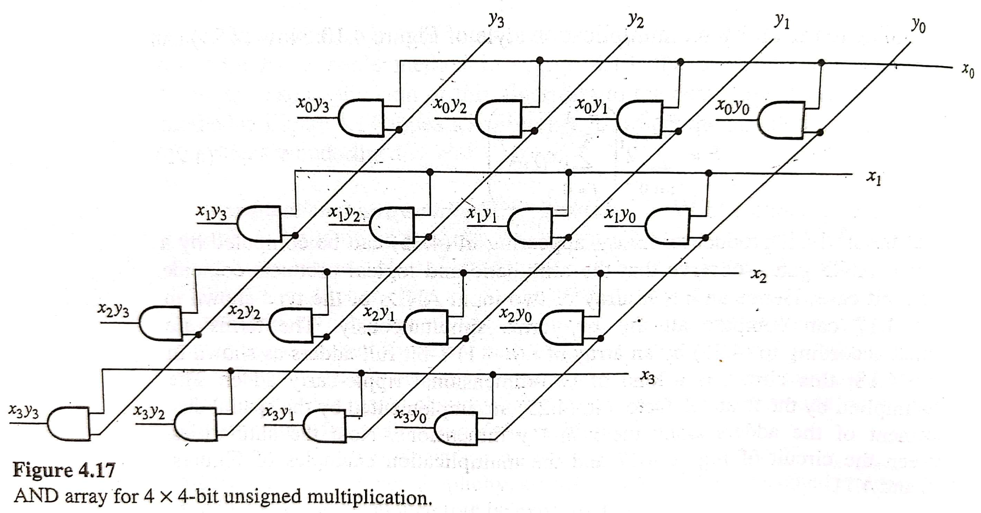
Observations
Multiplication of single digits in binary multiplication is just an “AND” operation
Multiplication of two n-bit numbers can be accomplished with (n-1) additions
Can use array of AND gates, HA’s, and FA’s
Question: Where is most of the “delay” in this design?

Slide 6
Division
In fixed point division two numbers a divisor V and a dividend D, are given.
The objective is to compute a third number Q, the quotient, such that Q * V equals or is very close to D.
For example, if unsigned integer format are being used, Q is compute so that
      D = Q * V + R
Where R, the reminder is required to be less than V, that is 0 <= R <= V. We can then write:
      D / V = Q + R / V
Here R/V is a small quantity representing the error in using Q alone to represent D/V; this error is zero if R = 0.

Slide 7
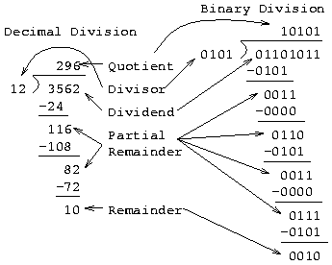
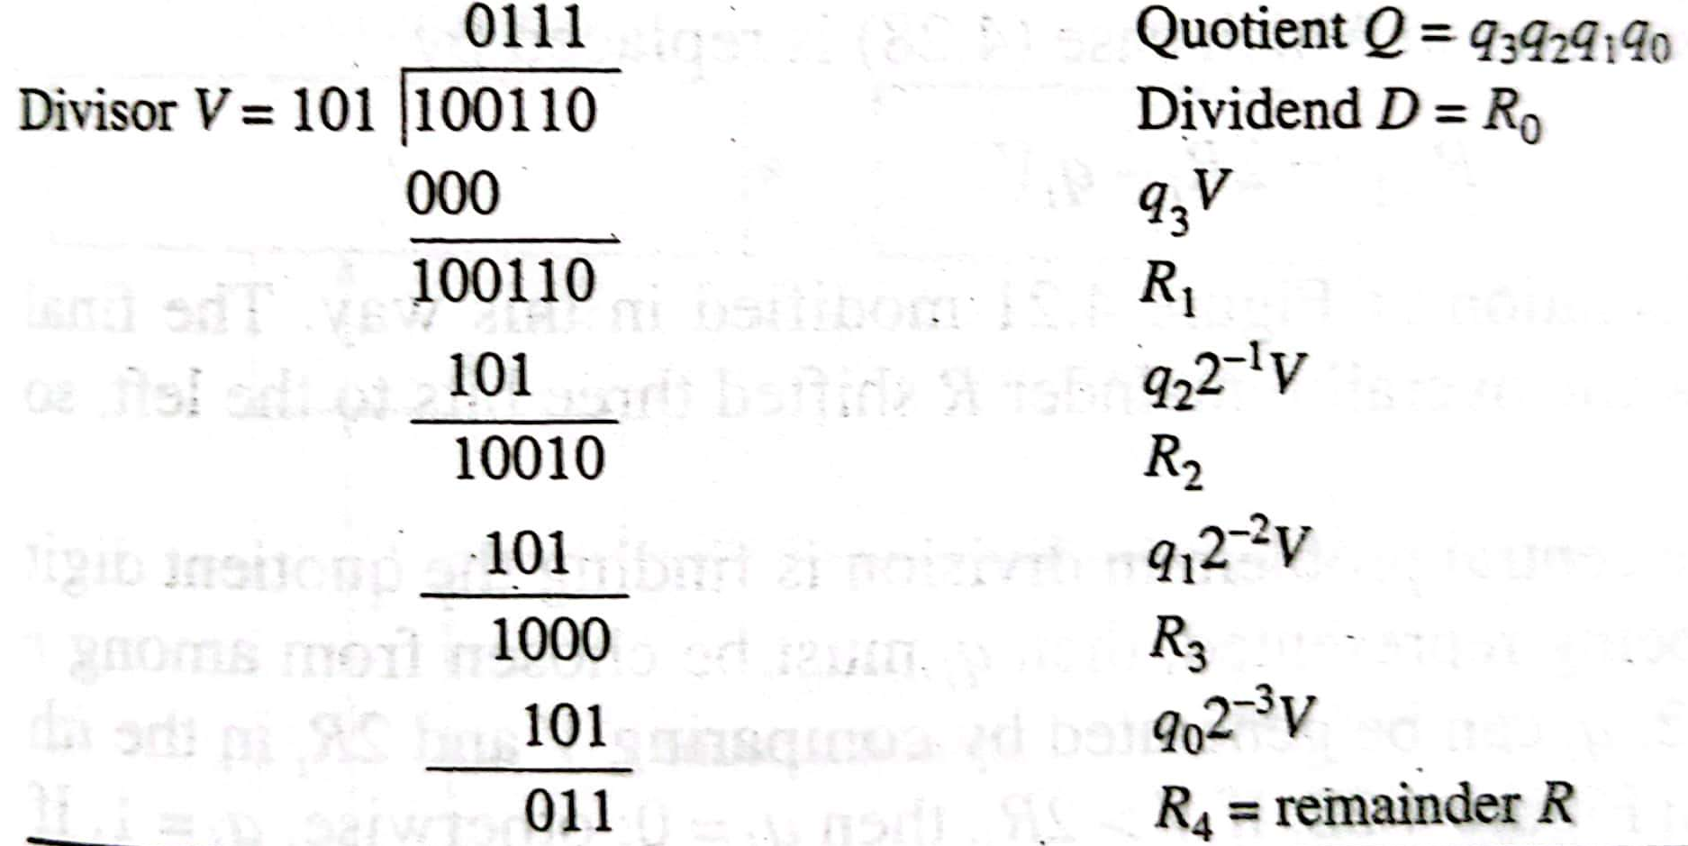
Division H/W
Paper-and-pencil Division Method

Slide 8
Coprocessor
Complicated arithmetic operations like exponentiation and trigonometric functions are costly to implement in CPU hardware, while software implementations of these operations are slow.
A design alternative is to use auxiliary processors called arithmetic coprocessors to provide fast, low-cost hardware implementations of these special functions.
In general, a coprocessor is a separate instruction set processor that is closely coupled to the CPU and whose instructions and registers are direct extensions of the CPU’s. [Fig: 4.45]

Slide 9
Coprocessor
A coprocessor instruction typically contains the following three fields:
An opcode F₀ that distinguishes coprocessor instructions from other CPU instructions.
The address F₁ of the particular coprocessor to be used if several coprocessors are allowed.
The type F₂ of the particular operation to be executed by the coprocessor.

Slide 10
Pipeline Processing
Pipelining is a general technique for increasing processor throughput without requiring large amounts of extra hardware.
It is applied to the design of the complex Datapath units such as multipliers and floating-point adders.
It is also used to improve the overall throughput of an instruction set processor [More details in Chap 5].

Slide 11
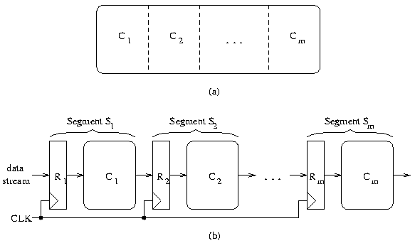
Pipeline Processing: Basic Structure
Data in
Data out

Slide 12
Pipeline Processing: Basic Structure
A pipeline processor consists of a sequence of m data-processing circuits, called stages or segments, which collectively perform a single operation on a stream of data operands passing through them.
Some processing takes place in each stage, but a final result is obtained only after an operand set has passed through the entire pipeline.
As illustrated in next Fig, a stage S_{i} contains a multi-word input register or latch R_{i}, and a Datapath circuit C_{i} that is usually combinational.
The R_{i}’s hold partially processed results as they move through the pipeline; they also serve as buffers that prevent neighboring stage from interfering with one another.
A common clock signal causes the R_{i}’s to change state synchronously.

Slide 13

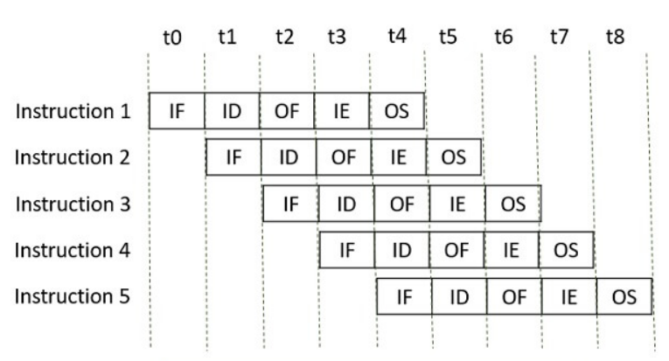
Pipeline Processing: Basic Structure
An instruction in a process is divided into 5 subtasks likely
In the first subtask, the instruction is fetched.
The fetched instruction is decoded in the second stage.
In the third stage, the operands of the instruction are fetched.
In the fourth, arithmetic & logical operation are performed on the operands to execute the instruction.
In the fifth stage, the result is stored in memory.

Slide 14
That’s All
Thank You

